Slide 1
Investigating the Development of Possible Selves in Teacher Education: Candidate Perceptions of Hopes, Fears and Strategies
Jill Gonzalez-Bravo
Dissertation Defense 2015

Slide 2
Student Achievement
Effective Teachers
Effective teachers impact student success in the classroom more than policies, reform initiatives, and even technology (Stronge et al., 2011; Nye, Konstantopoulus & Hedges, 2004).
Students of effective educators show gains despite issues of poverty, race, ethnicity, and language and learning differences (Aaronson, Barrow, & Sander, 2007; McMurrer, 2007; Sanders & Rivers, 2000).
The need for a student’s learning career to be directed by effective educators is evident in the positive residual effects of effective instruction (Hanushek, Kain, William & Sanders, 2000) and the opposing negative effects in classrooms of ineffective educators (Sanders & Rivers, 1997).

Slide 3
Student Achievement
Effective Teachers
Strong Professional Identity
Avalos (2011), Beauchamp and Thomas (2009), Freese (2006), Hoban (2007), Kagan (1992), Olsen (2008), and Sachs (2005) recognized professional identity development as central to teacher professionalism.
Many researchers have agreed that strengthening professional identities influenced teacher effectiveness, increased motivation, and may have decreased attrition (Avalos, 2011; Day, Elliot, & Kington, 2005; Day, Kington, Stobart, & Sammons, 2006; Johnson, Berg, & Donaldson, 2005; Lasky, 2005; Van den Berg, 2002).

Slide 4
Strong Teacher Identity
Identity Development
Apprenticeship of Observation
TE Instructional Strategies
Notes:
Cochran-Smith (2003), Ashton (1996) Ashton and Gregoire-Gill (2003) recognized that pre-service teachers were often unaware of their misconceptions. Therefore, teacher educators were encouraged to embed opportunities for making implicit beliefs explicit throughout coursework. Traditional theory-into-practice teacher education programs sadly neglect this practice and reinforce the simplicity of learning and teaching misconception (Ashton & Gregoire, 2003; Cochran-Smith, 2003; Korthagen et al., 2006). If pre-service teachers “start to believe that teaching is about translating theory into practice in a direct manner, the confrontation with the complexities of practice is shocking” (Korthagen et al., 2006, p. 1027).

Slide 5
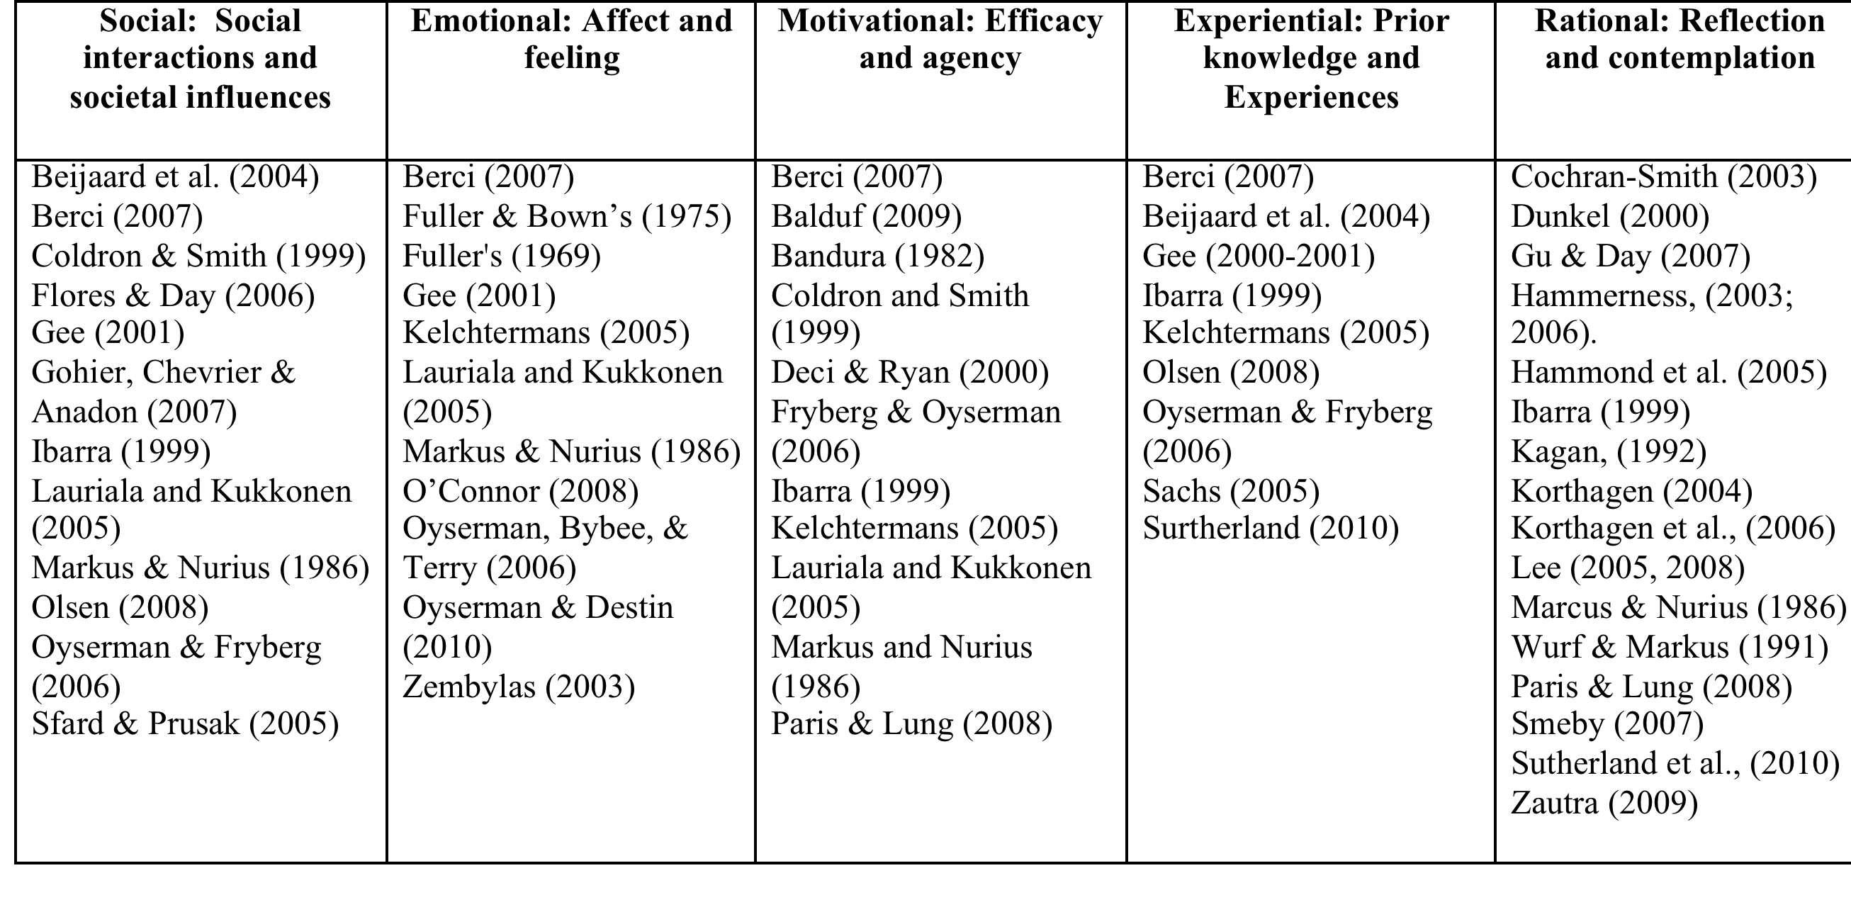

Slide 6
Mosaic of Influences that Shape Professional Identity Development
Rational
Social
Motivational
Social Interactions
Emotional
Efficacy
Experiential
Reflection
Societal influences
Affect
Agency
Prior Knowledge
Contemplation
Feeling
Prior Experiences
Jill Gonzalez-Bravo, 2015
Jill
Gonzalez Bravo

Slide 7
The Theory of Possible Selves as proposed by Markus and Nurius (1986)
Strong Teacher Identity
Identity Development
Apprenticeship of Observation
TE Instructional Strategies
Notes:
The American Education Research Association (AERA) Panel on Research and Teacher Education (Cochran-Smith & Zeicher, 2005) concluded a four-year study on research in teacher education with suggestions for improving the body of knowledge. After reading this report and blending it with her own experiences and observations I attempted to design a study that intentionally addressed two identified shortcomings and suggestions within teacher education
Ground research in relevant theoretical frameworks.
research must extend upon previous findings
Benefits of self-study
Marzano and Heflebower (2012) promoted the inclusion of conative skill development to better prepare are students for the 21st century. Marzano and Heflebower (2012) proposed several strategies including the theory of possible selves to promote conative skill development and self-efficacy. The possible selves theory, which emerged from self-concept theories in psychology, had only more recently been applied to the field of education (Packard & Conway, 2006).

Slide 8

Theoretical Framework
Fletcher (2000)
Conway & Clark (2003)
Grossman and Ronfeldt (2008)
Hamman , Gosselin, Romano, Bunuan, (2010)
Hong (2012)
Hamman, Wang, and Burley (2013)

Slide 9
Salient Possible Selves
Teacher Selves
Professional Interpersonal Relationships
Classroom Management
Professionalism
Instructional Strategies
Hamman et al. (2010)

Slide 10
Research Questions
1. How do candidates describe and develop hope achievement and fear avoidance strategies in regards to previously identified salient possible selves (Hamman et al., 2010)?
  Coded: Ibarra (1999)
2. How do candidate identified strategies inform teacher education?
  Coded: Korthagen et al. (2006)

Slide 11
Possible Selves Theory Method
Me-Reflection
Memories
Motivation
Means-Development
Membership
Modeling
Mentoring
Mirroring

Slide 12
Affirmations of the Current Research
Teacher educators influenced professional identity development
Intentional placements and effective clinical mentors shaped candidates’ reflective practice
Observation played a limited role in candidates’ professional identity development
The theory of possible selves prompted participants to make explicit implicit beliefs and motives (Ashton, 1996; Ashton & Gregoire-Gill, 2003; Cochran-Smith, 2003; Markus & Nurius, 1986)

Slide 13
New Understandings
Secondary participants’ strategies emphasized attributes of future professionalism however they identified several external influences impeding professional development:
  Limited observation of modeled effective instruction
  Limited membership perspectives and isolation fears.
Limited understanding of membership strategies and conflict resolution.
Teach educator modeling of affective traits shaped participants’ professional identity development.

Slide 14
Level of Significance
Theoretical: utilitarian, investigative and evaluative qualities of the theory of possible selves applied to teacher identity development explorations.
Practical: allows for the candidate evaluation, needs identification, and appraisal of preparation program effectiveness.

