Slide 1
An Expansion of
Mildred Bangs Wynkoop’s
1971 WTS Article:
A Hermeneutical Approach to John Wesley

Slide 2
By
Randy Cloud, PhD
Chair: Department of
Christian Ministry and Formation
MidAmerica Nazarene University

Slide 3
Presented at the
Wesleyan Theological Society
50th Anniversary Meeting
Mount Vernon Nazarene University
March 5-7, 2015

Slide 4
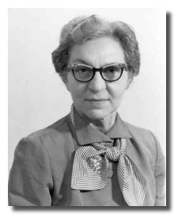
Dr. Mildred Wynkoop
A Theology of Love: The Dynamic of Weslevanism

Slide 5
Key Hermeneutical Questions
1. The “What?” Question: Textual Apparatus
2. The “Where?” Question: Social Context
3. The “How?” Question: Rhetorical Criticism
4. The “When?” Question: Development and Maturity
5. The “With Whom?” Question: Sources and Subsequent Thought
6. The “Where Now?” Question: Current Directions of Inquiry
7. The “Who?” Question: Mentor or Guru
8. The “What Now?” Question: Wesley in the Marketplace

