Slide 1
Holding God Close
Through Technology
The Silence & Solitude Challenge
Kelvin St. John & MNU Millennials

Slide 2
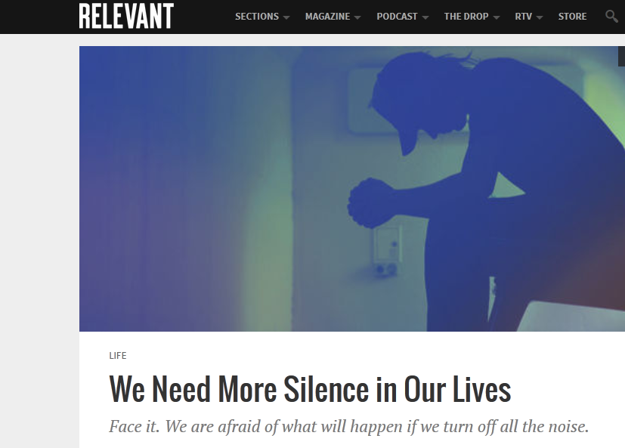


Louis Spivak in Relevant's Nov/Dec 2014 issue
Silence is almost extinct.
We think we have to listen to the cultural roar.
Silence helps us feel.
Choosing quiet requires courage.
This worthy read was found by Whitney Newman.

Slide 3
Louis Spivak in Relevant's Nov/Dec 2014 issue
With silence, healing begins.
God doesn’t compete.
He beckons.
He says, “You belong.
You are loved.
You are mine.”
This worthy read was found by Whitney Newman.

Slide 4

Strategies for Silence & Solitude
A Simple Strategy to Silence Your Internal Scripts
We all have a tendency to have internal scripts or conversations that run in our heads.
To disarm them, sit with a writing pad or post-it notes when you practice silence & solitude.
As ideas occur to you, grab a pen or pencil and write it down.
Then return to silence knowing you can take care of that item once you have finished being silent.

Slide 5
Strategies for Silence & Solitude
An Ancient Church Exercise to Prepare for Silence & Solitude
Subtraction Exercise
    Subtract the last word each time you repeat Psalm 46:10:
        Be still, and know that I am God
        Be still, and know that I am
        Be still, and know that I
        Be still, and know that
        Be still, and know
        Be still, and
        Be still
        Be.

Slide 6
Strategies for Silence & Solitude
An Ancient Church Exercise to Prepare for Silence & Solitude
Listening Exercise
Sit in your chair, upright but comfortable, with your back supported.
Now just notice the sounds that you can hear, sounds far away.
Just hear them, don’t even try to name them.....
Notice fainter sounds, than sounds which are nearer.
Just listen, become aware of them.....
And the sound of your own heartbeat, faint, but your own rhythm of life....
And the sound of silence in your place of prayer, the silence within yourself....
Listen like this for a few minutes.

Slide 7
Prompts to Prepare for Silence & Solitude
Day 1 - Sunday
  Dear Jesus, as I call on you today I realize that I often come asking for favors.
  Today I’d like just to be in your presence.
  Let my heart respond to Your Love.
Day 2 - Monday
  My soul longs for your presence, Lord.
  When I turn my thoughts to You,
  I find peace and contentment.
Day 3 - Tuesday
  “Come to me all you who are burdened
  & I will give you rest”
  Here I am, Lord.
  I come to seek your presence.
  I long for your healing power.
Day 4 - Wednesday
  I pause for a moment and think of the love and the grace that God showers on me: I am created in the image and likeness of God; I am God's dwelling-place
Day 5 - Thursday
  Lord, help me to be fully alive to your Holy presence.
  Enfold me in your love.
  Let my heart become one with yours.
Day 6 - Friday
  I pause for a moment and reflect on God’ s life-giving presence in every part of my body, in everything around me, in the whole of my life.
Day 7 - Saturday
  Dear Lord as I come to you today
  Fill my heart and my whole being with the wonder of Your presence

Slide 8
Quick Stats
243 joined the Silence & Solitude Challenge
20 or 8.3% never participated.
188 completed the Informed Consent form
177 subscribed to the Remind.com app.
6 Weekly Surveys in Moodle gathered data.
An average of 146 completed the Weekly Surveys.
The surveys produced 8,666 pieces of data (student comments).

Slide 9
Participants per Week

Slide 10
How did your experience of silence & solitude impact you spiritually this week?
16 – It gave me peace
8 – Felt God’s presence
8 – Lost focus
7 – Closer to God
7 – Spiritual standstill / stayed the same
Other responses:
Learning to be still
Thankful
Focused on God
Stronger relationship / Better relationship / Deeper relationship
Hear God
The Challenge helped me
Self-acceptance

Slide 11
How did your experience of silence & solitude impact you spiritually this week?
I had more encouragement from God. I felt his calming hand on my shoulder when I normally would have been quite irritated or frustrated.
It is easier to recognize God’s voice. I felt more connected with God throughout the week and was able to be more aware of his presence.
I feel closer to God. I can feel his presence in my day to day life.
It is a really freeing feeling, knowing He is so close.

Slide 12
How has this habit of silence & solitude affected your life in general?
(Think emotional, relational, and attitudinal, to name a few.)
23 – Peaceful / calmed down / less stressed
10 – Positive attitude
7 – Slowing effect
Other responses:
Happier
Closer to God
More patient
No change
Hard to be silent

Slide 13
How has this habit of silence & solitude affected your life in general?
(Think emotional, relational, and attitudinal, to name a few.)
Before this challenge I hated any silence. I had a list of topics I could talk about when there was an awkward silence. Now I have come to love the silence. Sometimes silence is the best thing you can do.
It has helped me to keep calm when life throws punches, and to rely on God to help me through it.
I have been less angry and annoyed but more upbeat and happy. I find myself enjoying things of the day much more and not just wanting the day to end.

Slide 14
Has your practice of silence & solitude changed your relationship with God?
21 – Closer to God
12 – No change
12 – I listen better
8 – Growing relationship
7 – Depend more on God
5 – God as friend
3 – Connected to God
3 – Felt God’s Presence

Slide 15
Has your practice of silence & solitude changed your relationship with God?
I feel more accepted by God
I've felt a lot more in tune with God.
I am more aware of how I spend my time, and I anticipate those few moments of silence. My prayer is that after the challenge is over to continue to practice silence.
I trust Him more than I did before. Every time I was silent I could feel His presence and I knew that He was there.
It made the relationship a two-way street and not just a me-me-me prayer.
It's become a daily, not weekly, relationship.

Slide 16
What strategies best led you to being silent before God?
35 – A set place
33 – Hooked to daily routine
30 – No distractions
28 – A set time
22 – Cell alert (reminder, alarm)
10 – Right attitude or mindset
7 – Some type of prompt
7 – Became habitual

Slide 17
What strategies best led you to being silent before God?
I would go outside or close the dorm door and curl up in bed.
I would turn my phone off or put it where I couldn’t see it.
I would find a place with no noise: in my car or in my room or in a classroom, all of those places led me to be silent towards God.
Believe it or not, a hot morning shower. Yes. This really helped me to relax and just be silent and listen.
I would usually just do it whenever I ran.
I listened to an app called Relax Melodies. It helped me tune into God and tune out the world.

Slide 18
If you were to repeat this Challenge, how might you modify it?
34 – Make no change
9 – More daily reps
5 – Accountability groups or pairs
3 – More articles
3 – More Remind.com texts to my cell

Slide 19
If you were to repeat this Challenge, how might you modify it?
I would try to be silent for more than just once a day.
I loved it!! Only thing might be to start an accountability group or have an accountability partner.
I would read more excerpts beforehand to think about. They got my mind ready to be silent. They focused my thoughts.
I’d like to have Remind.com texts everyday.

Slide 20
Do you have any additional observations or thoughts that you would like to share with St. John?
17 – Thanks for the Challenge
4 – The Remind.com texts helped
4 – Appreciated the opportunity
4 – Enjoyed it
4 – Plan to continue
4 – Closer to God
2 – Stronger faith

Slide 21
Do you have any additional observations or thoughts that you would like to share with St. John?
I am glad you sent daily reminders on Remind.com because it helped me to not push the silence away.
I'm thankful how these challenges help me seek God in a different way than I'm accustomed to.
Keep it up St. John! You helped me get closer to the Lord.
It really opened my eyes to how “busy” I make my life, when in reality God deserves my time! I need to at least honor him with 5 minutes a day!
Thanks for a cool project! It has changed my life and relationship with God forever. I don't think I would have ever tried to see for myself that I can improve my relationship with God in minutes a day!

Slide 22
How has this habit of prayer affected your perception of God?
34 – God’s Presence
16 – God as friend
15 – God listens to me
11 – God speaks
7 – Relationship with god
7 – God is bigger
7 – Listen to God
6 – God loves me
5 – No change

Slide 23
How has this habit of prayer affected your perception of God?
God is closer to me.
I used to think of God as more of a distant, silent type. Now I’m realizing that I was the one who was distant, and that the silence was a misunderstanding because I wasn’t being a very good listener.
Listening to God is done in His own timing and He often speaks to us over long periods of time.
God takes my time very seriously and spends time with me intimately when I am intentional.
I moved from “God doesn't listen and I'm invisible to him” to
“he does listen and care.”

Slide 24
How would you explain to non-participants the impact this Challenge has made on you?
19 – Peace
17 – Stronger relationship
15 – Closer to God AND connected to God
13 – Power of silence
12 – Reduced stress
9 – Hear God
5 – Became a habit, Found rest, Aware of God’s Presence,
More focused / refocused, Learned about myself

Slide 25
How would you explain to non-participants the impact this Challenge has made on you?
It’s a habit with benefits!
I am more calm and collected both emotionally & spiritually.
Silence is hard for me to accomplish. However, being silent before God gave me a peace that I had not found anywhere else.
God waits for us to quiet our souls to really begin to speak to us.
It made me breathe.
It re-amped my relationship and re-energized my faith.
By taking time out with God I have felt detoxed. It helped flush out all the toxic parts that filled me and made me angry with myself and God.

