Slide 1


JESUS FILM HARVEST PARTNERS
To give every person an opportunity to hear about Jesus Christ.
Notes:
Thank you for being here today!
I want to take a minute to tell you why I am so invested with JESUS Film Harvest Partners.
- I became involved as a Harvest Partner… (date, person who initiated your involvement, story…)
- I remain involved because… (good use of my time, I know this makes a difference…)
- Please receive my appreciation for your part in this movement of God.

Slide 2
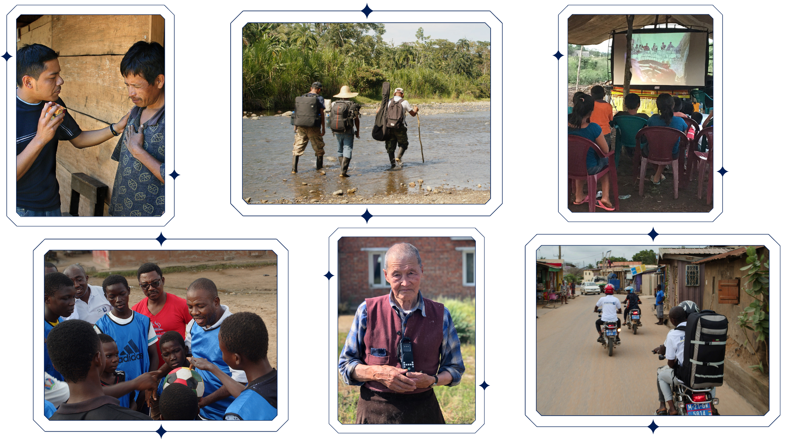
Notes:
JESUS Film Harvest Partners is a Kingdom-building ministry devoted to world evangelism through the JESUS film and other tools.
Harvest Partners equip and support JESUS Film teams of local people to do evangelism, discipleship, and church planting.

Slide 3



JESUS Film teams
countries
languages
1,166
65
212
Notes:
Before I get into how you can get involved in the ministry, I want to share a little about what God has done through JESUS Film teams over the last 25 years as well as this past quarter.
This year, 1,166 teams are working in 65 countries around the world, sharing the gospel in 212 languages!

Slide 4




94 million +
evangelistic contacts
19.3 million +
decisions for Christ
9.5 million +
discipleship follow-ups
140,000 +
Preaching Points
Notes:
Over the life of the ministry, JESUS Film teams have reported…
Over 94 million evangelistic contacts
More than 19.3 million people have made decisions for Christ
9.5 million new believers discipled
And over 140, 000 Preaching Points have been planted

Slide 5

Notes:
Let’s break these numbers down to give you some perspective.
In the last 90 days, 61,690 people made decisions for Christ
That’s enough to fill an average NFL stadium!

Slide 6
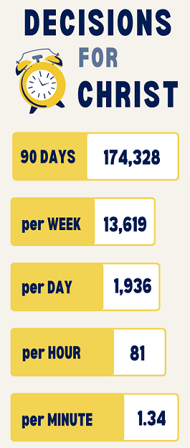
Notes:
The stats pictured break this number down by week, day, hour, and minute.
That equates to
13,619 per week
1,936 per days
81 per hour
1.34 per minute
Doesn’t that put a new perspective on making every moment count for Christ?

Slide 7
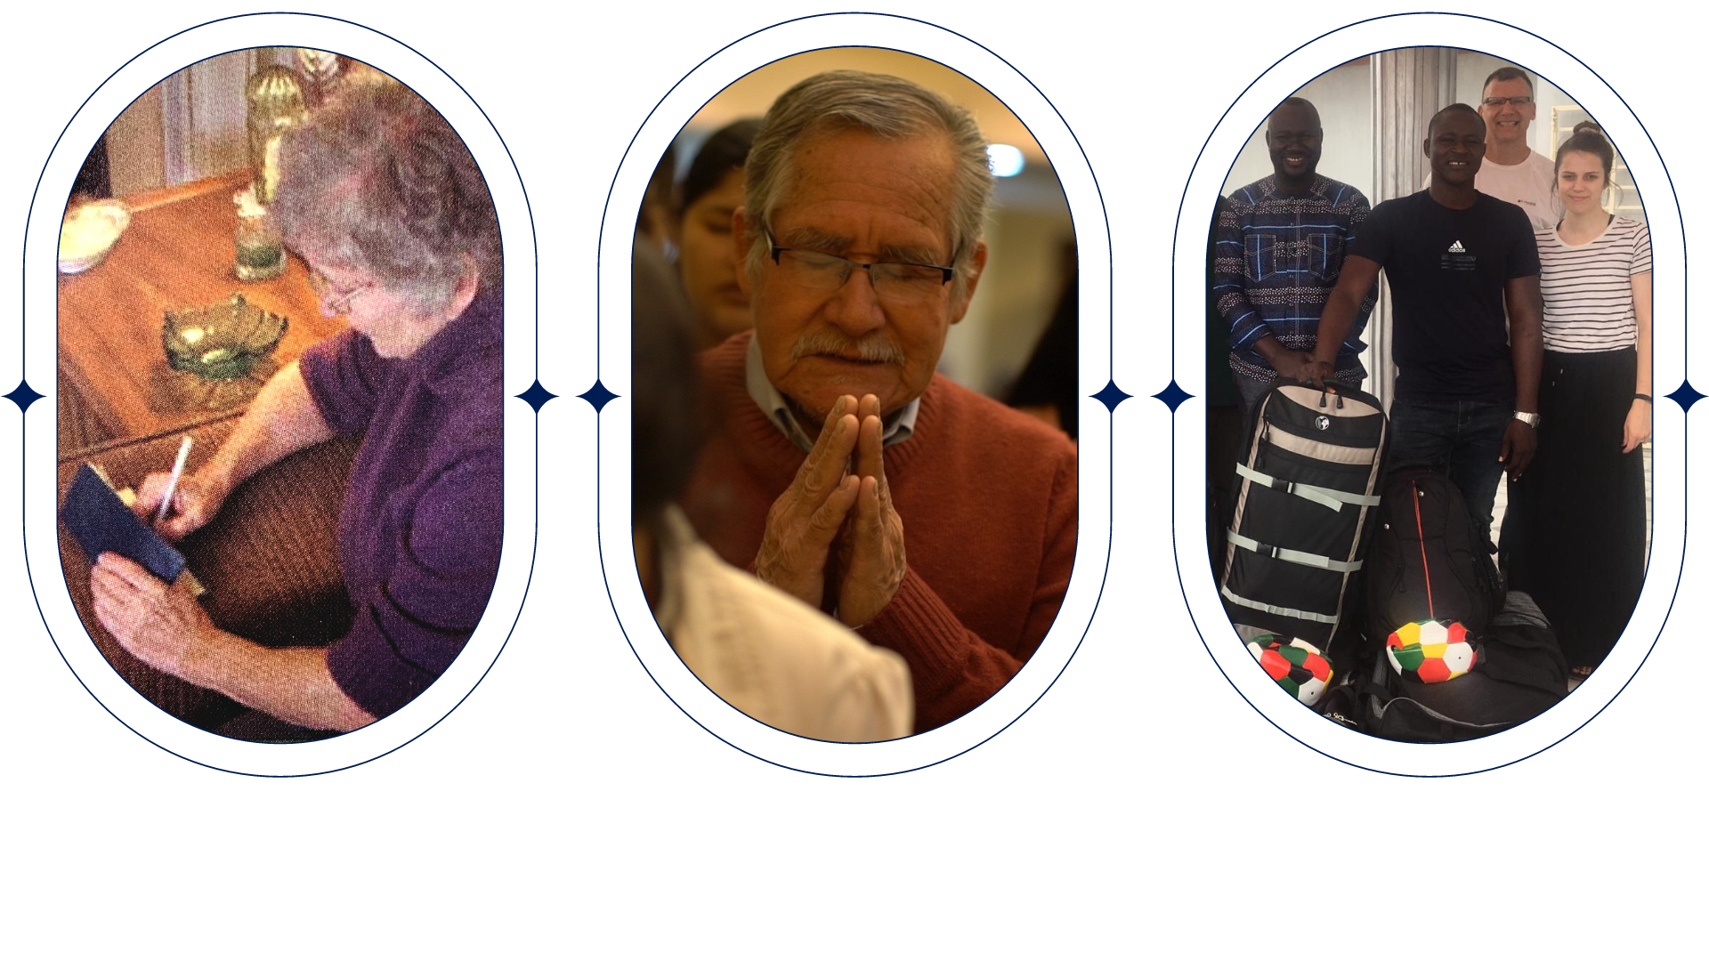



Support teams: pray – give - go
Notes:
What the teams do is so powerful: local people in their own country evangelizing to their neighbors
Because that method is so effective, what we do here is important – the teams need our support through prayer, giving, and going.

Slide 8
“Be joyful in hope, patient in affliction, faithful in prayer.”
— ROMANS 12:12 —
Notes:
Romans 12:12 says: Be joyful in hope, patient in affliction, faithful in prayer.
Prayer is so important to this ministry – Lifting up both the spiritual victories and challenges before God.
Sharing the gospel is not easy for many teams, especially in nations where Christians are persecuted for their faith.

Slide 9
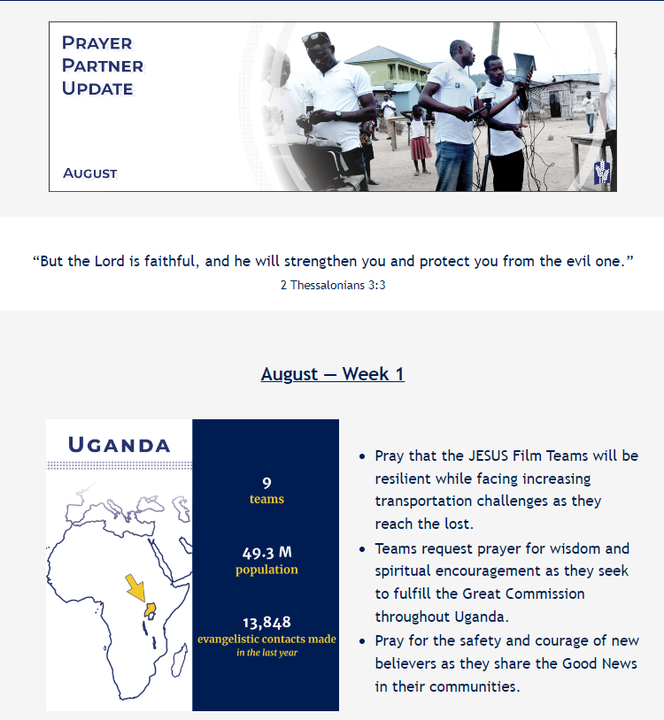
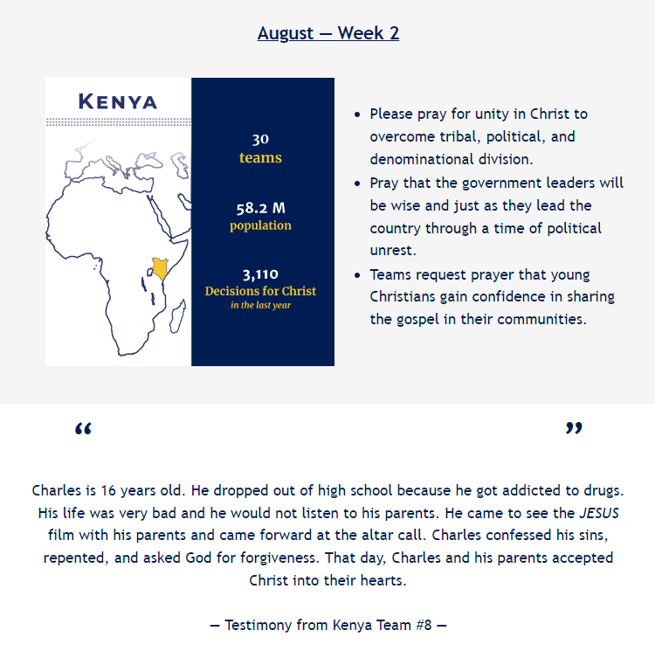
Notes:
As a prayer partner, you receive a monthly email. Here’s an excerpt from August’s Prayer Partner Update. It includes the number of teams, population, and a highlight from the teams’ reports from the last year, focusing on a different country each week.
You can also follow along with their praises and prayer requests. Each month also features an incredible testimony from one of the highlighted countries.

Slide 10

91% of JFHP funding goes to the field!
Notes:
JESUS Film teams are willing and ready to go to the hard places to share Jesus, but they need our support!
Donating to JESUS Film Harvest Partners is a great return on investment.
91% of donated dollars go to the field while the other 9% for admin and development.
You are able to be a part of lives changed in other countries without even having to leave the country!
One way you and I can support the ministry today is providing an equipment set to a team in need!

Slide 11

Notes:
When the ministry started 25 years ago, JESUS Film teams were using 16 mm equipment sets, which weighed over 200 pounds. It took around 8 people to carry all the pieces!
Today, one person can carry a full equipment set in one 35-pound backpack!

Slide 12
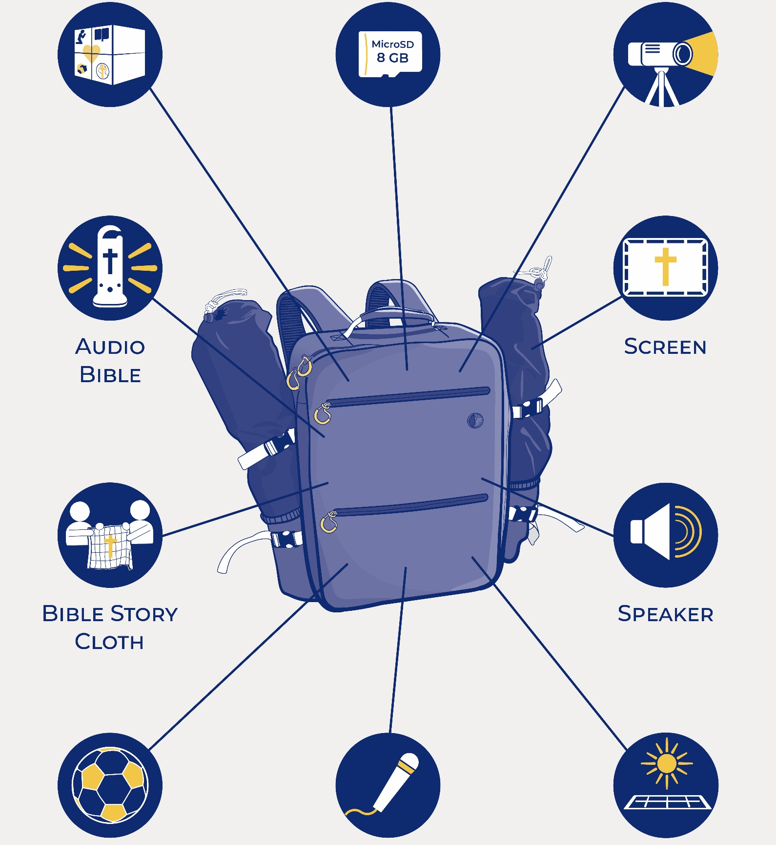
Projector
92-inch screen frame
Solar-powered battery
Speakers
Tripod
15-Watt solar panel
MicroSD card
Solar-powered flashlight
EvangeCube
Evangelism Soccer Ball
Bible Story Cloth
Audio Bible
Only in Large Solar Set:
Amplifier; Microphones
Notes:
All of the items pictured here are included in the Small and Large Solar Sets!
The main difference between the two is how many people can hear the film and JESUS Film team preach — up to 200 with the Small Set, and up to 1,000 with the Large Set.
The Small Solar Set is most requested by teams in South America, who often show the film in homes and smaller villages.
The Large Solar Set is most requested by teams in Africa, Mesoamerica, and Eurasia, where the film draws large crowds.

Slide 13
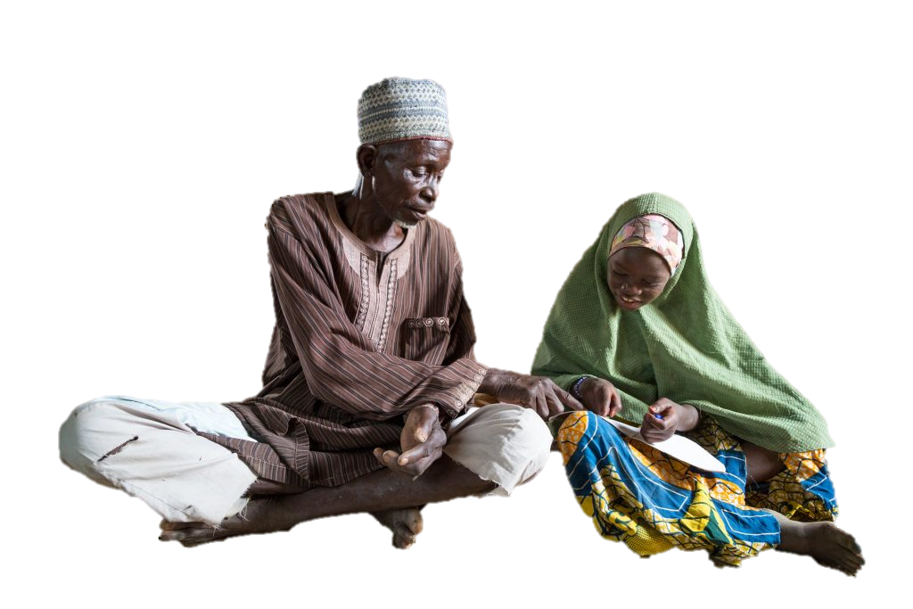
Small Solar Set: $2,000
Large Solar Set: $4,000
“God still
transforms
hearts for His Kingdom!”
Notes:
For $2,000, we can provide a JESUS Film team with a Small Solar Sets, or for $4,000, we can provide them with a Large Solar Sets. Both sets provide many more opportunities for people to hear the Good News.
Here’s a report from a JESUS Film team in Niger: “We went to a village with the hope of planting a new Preaching Point. The head of the village eagerly hosted the film showing in his home. Afterward, he and his entire household gave their lives to God! Then, all of the surrounding houses — 43 people in total — made decisions for Christ. God still transforms hearts for His Kingdom!"
Will you prayerfully consider equipping a team and partnering with God to help build the Kingdom through a small or large solar set?

Slide 14
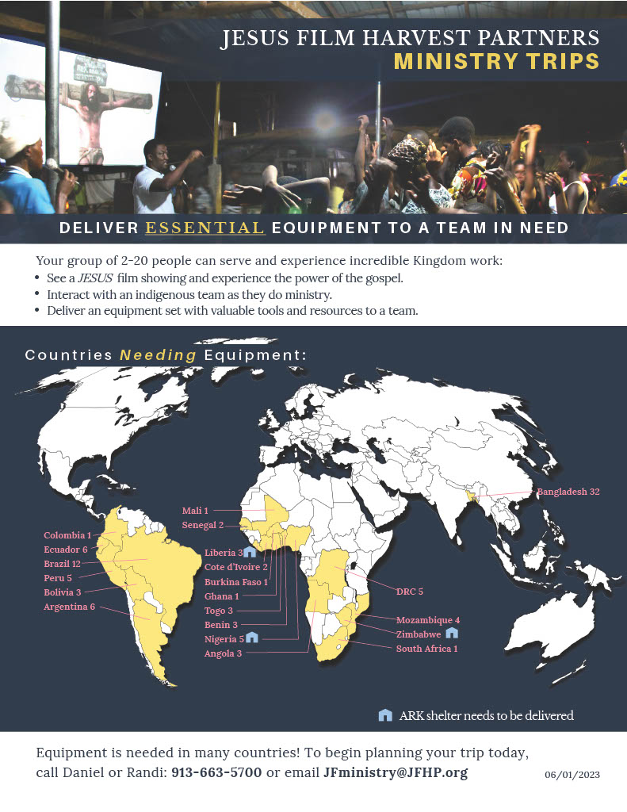
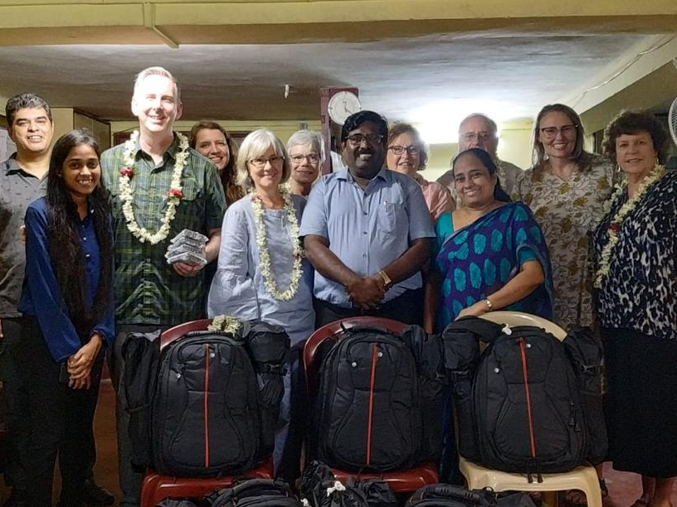
Equipment Angels
& Ministry Trips
Notes:
You can also help JFHP by going on a trip to deliver equipment to a team in need!
Equipment angels: you pick the destination and JFHP provides the equipment. We put you in contact with a leader in the field to arrange an equipment drop-off.
On a ministry trip, your church or small group raises funds for an equipment set, delivers it to a JESUS Film team, and participates in the ministry, usually for a week.
On JFHP’s website, there is a downloadable handout that is updated each month, which shows what countries need equipment, and how many teams are waiting for sets there.

Slide 15
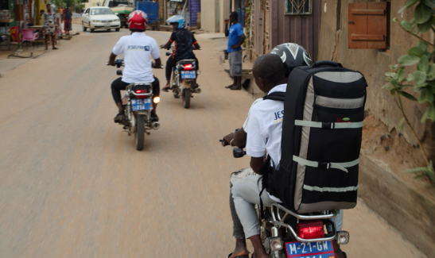
Thank you for
helping change
lives for eternity!
Notes:
I hope learning how you can pray, give, and go through JESUS Film Harvest Partners has been encouraging! I believe each of us has an important part to play.
Through you as a Harvest Partner, people will come to know Jesus Christ, families will be made new, and whole villages will be transformed.
Please let me know if you have questions, and I will help you get in contact with the appropriate person at JFHP.

Slide 16




Get Involved
JFHP.org/Small
JFHP.org/Pray
JFHP.org/Go
JFHP.org/Large

